Slide 1
ARU Monitoring and Anomaly Detection
Business Area: Claim Processing monitoring automation
Project Leader : Amit Malik
By : Milind Wadhwa

Slide 2
Business Case
Nature of monitoring in almost all Support teams(SSS) is manual. Some monitor job logs and some do monitoring through E-Mail notifications.
This business case is about ARU (Automated Resolution Utilities) team where monitoring is done through emails. 3-4 people perform monitoring on daily basis and have to scan through email body to detect any failures. They don’t have information about error trends for a job or application.
ARU needs an automation which will help to promptly detect failures and take action based on current and future failures.

Slide 3
Problem Statement
Claim Processing
No information on the claim failure trends and reasons
Email Monitoring
No automated monitoring of the job failure e-mails
E-mail arrival trends are not analyzed

Slide 4
Goal Statement
Monitor received claims count for better insights
Monitor claims that have been processed, skipped or failed by ARU Robots
Predict claim status and plan accordingly
Find anomalies in the monitoring e-mail arrival schedule.
All keyword based search through monitoring emails for a longer time horizon / timeline

Slide 5
Project Benefits
Improved monitoring of claim processing
Risk mitigation in processing of claims
Knowledge about claim processing trends which help to focus on specific areas responsible for failures
Easily searchable monitoring e-mails for failure reason detection
Data used
Analyzed 9.8 million claims which were adjudicated by ARU
Analyzed emails from Apr, 2018 till date.
New email information is being ingested in real time as we speak
** Email based monitoring using machine learning can be used by any support team.

Slide 6
Technology Used
ELK Stack
Elasticsearch - The open source, distributed, RESTful, JSON-based search engine. It is based on Apache Lucene (Information retrieval software library)
Logstash - Logstash is an open source, server-side data processing pipeline that ingests data from a multitude of sources simultaneously, transforms it, and then sends it to your favorite “stash.”
Kibana - Kibana lets you visualize your Elasticsearch data and navigate the Elastic Stack.

Slide 7
Technology Used
X-Pack Extension
Bundles security, alerting, monitoring, reporting, graph and
machine learning capabilities into one easy-to-install package
Machine Learning –
Unsupervised clustering algorithms based on probabilities
Detect outliers in a population by building a profile of a “typical” user or machine to know when one starts to stray from the pack
Types of jobs :-
Single Metric – One detector
Multi Metric – More than one detectors
Population – Anomalous records in a population
Advanced – Combination of above three

Slide 8
Work-Flow Diagram
Logstash
Data parsing and Transformation
Elasticsearch
Data indexing and searching
Kibana
Data analytics and visualization

Slide 9
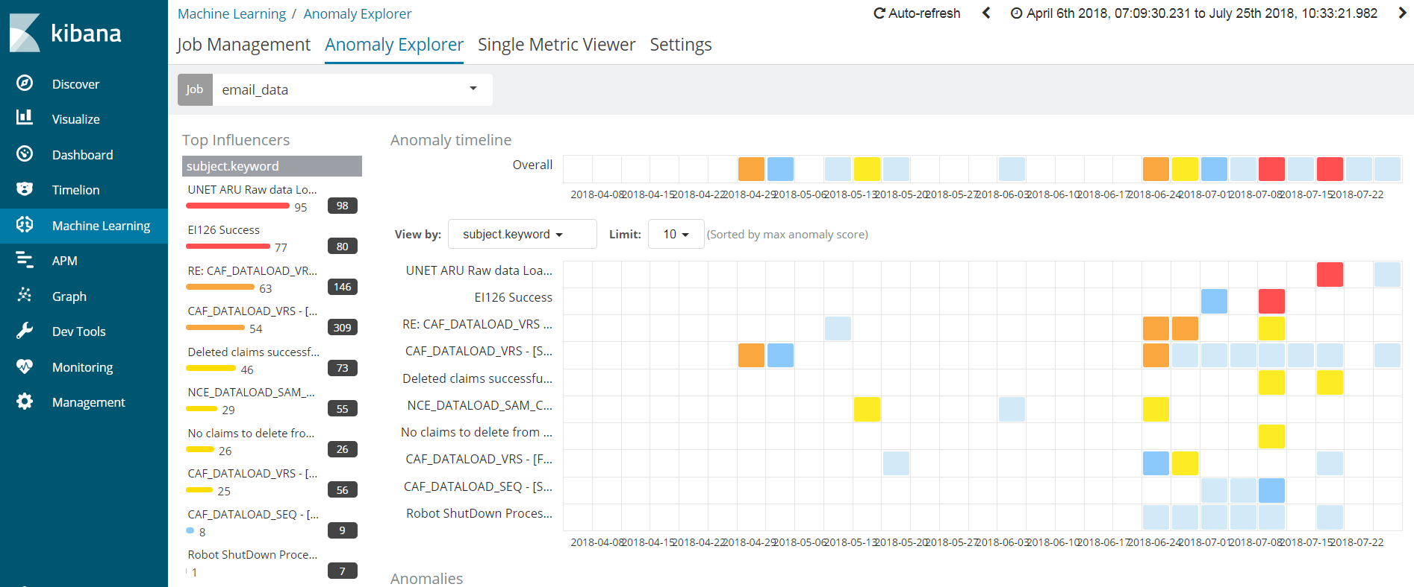
Anomalies in E-Mail Arrival

Slide 10
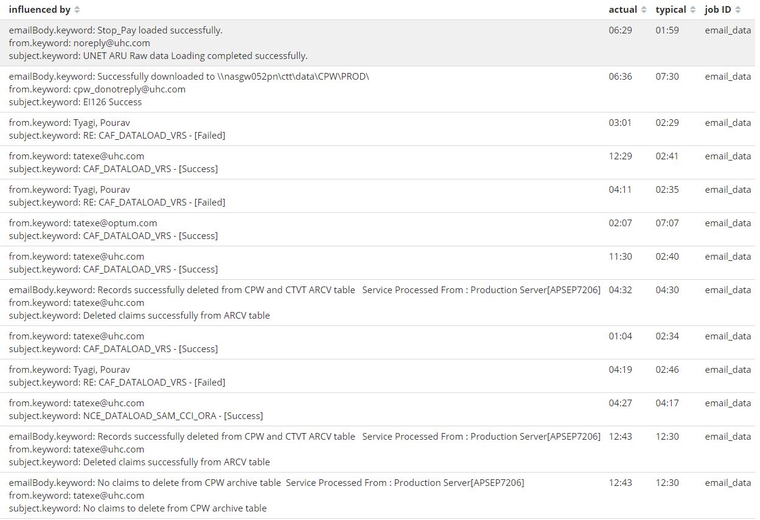
Actual vs Typical Arrival Time

Slide 11
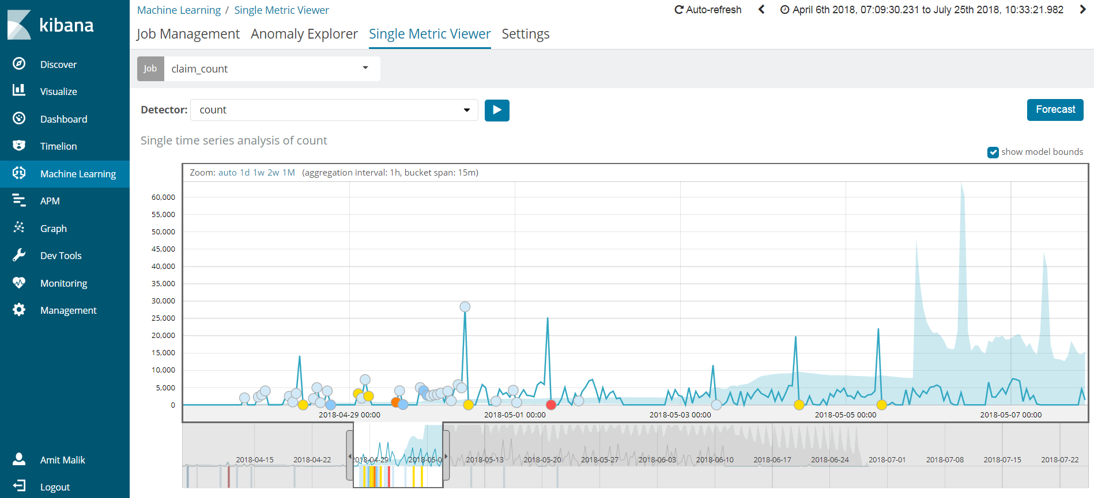
Claims Count Trends

Slide 12
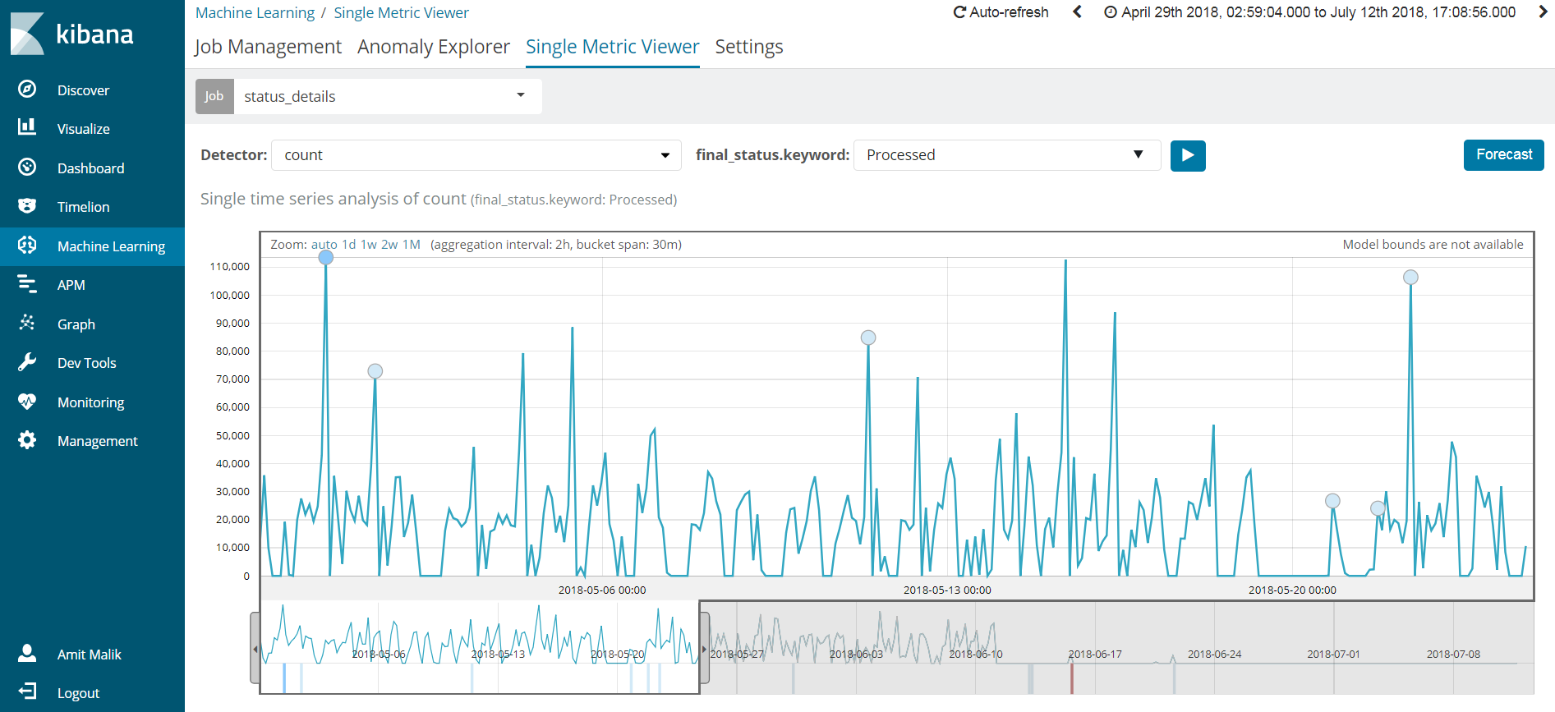
Claim Status Forecasting

Slide 13
Solutions
S.No | Issue/Problem Identified | Proposed Solution | Status
1. | There is no information on the claim failure trends | Analyze claim processing data for get insights for failures | Complete
2. | There is no way to get the trend of processing results of claims by ARU Robots | Analyze and then predict the claim status results | Complete
3. | There is no way to detect delays in email arrival time | Generate model to detect anomalies in email arrival time | Complete

Slide 14
Thank You

